Slide 1
COTTON LEAF DISEASE DETECTION USING ResNet
By
Meraz Hossain(19301152)

Slide 2
Motivation
Bangladesh is well known for its agriculture production.
In general, when a plant is afflicted with a disease, the leaves are the primary indicator of the disease.
The production can be increased and quality can be improved by the use of technology.

Slide 3
Problem Statement
Agriculture is Largely Affected by This
Solve the Problem for Many Mankind
Used Best performing CNN Architecture
Vanishing And Exploding Gradient Problem

Slide 4
Methodology
Used ResNet Architecture
Data Preprocess
ReLU Activation Function for Hidden layer
Softmax activation For Output Layer

Slide 5
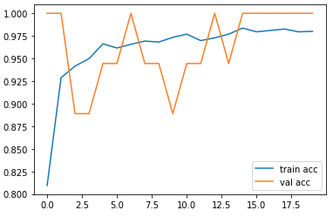
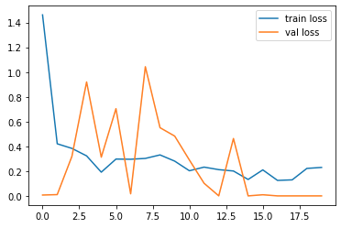
Result & Discussion
we have found that the accuracy rate of the ResNet model in our project is roughly around 98%.
This model could be able to detect almost all the leaves that are infected by the disease.This accuracy figure is from our implemented code.
Fig1 : ACCURACY PLOT
Fig2 : LOSS PLOT

Slide 6
Conclusion
The combined ResNet approach improves the model's feature extraction capabilities
ResNet reducing computation time without sacrificing discriminative construction.
According to the results analysis, the proposed model performed well on both the large repository and the cotton disease image dataset.

Slide 7
Future Scope
Future work could also be devoted to automatically estimating the severity of these diseases.
Farmers can be provided with immediate solutions by developing mobile-based applications.
Web portals can be used to provide online plant disease solutions.
Colab Link : https://colab.research.google.com/drive/1Ul82khVk9YM8pu-U1e-aaiCu8LT_d-4h?usp=sharing

